Slide 1
Preprocessor in C programming
Md. Alamgir Hossain
Senior Lecturer,
Dept. of CSE, Prime University, Dhaka
Mail: alamgir.cse14.just@gmail.com

Slide 2

Preprocessor
The C preprocessor is a macro preprocessor (allows you to define macros) that transforms your program before it is compiled.
These transformations can be the inclusion of header files, macro expansions, etc.
All preprocessing directives begin with a # symbol. For example, #define PI 3.14

Slide 3
Some of the common uses of C preprocessors

Slide 4
Including Header Files: #include
The #include preprocessor is used to include header files to C programs. For example, #include <stdio.h>
Here, stdio.h is a header file. The #include preprocessor directive replaces the above line with the contents of stdio.h header file.
That’s the reason why you need to use #include <stdio.h> before you can use functions like scanf() and printf().

Slide 5
Macros using #define
Macro in C programming is known as the piece of code defined with the help of the #define directive.
Macros in C are very useful at multiple places to replace the piece of code with a single value of the macro.
Macros have multiple types and there are some predefined macros as well.

Slide 6
Macros in C Language
Suppose we are working on an application in C language and there is one value or an object or segment of code which we require so many times in our code then with the help of macros we can define it once and use it many times.
Macros are one of the convenient ways to write robust and scalable code.
Whenever the compiler encounters the macro, it replaces the macro name with the macro value. Two macros could not have the same name.

Slide 7
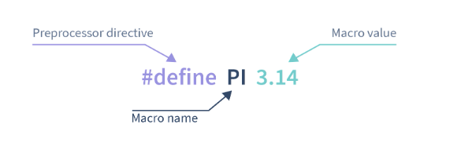
Macros in C Language

Slide 8
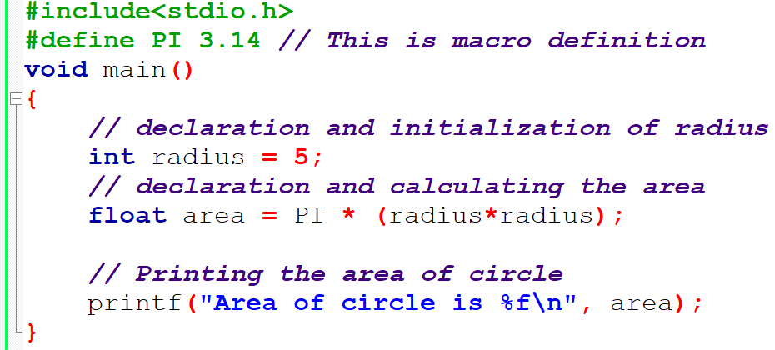
Example

Slide 9
What are Preprocessor and Preprocessor Directives in C Programming?
Whenever we write a certain code in C language, it goes through the process of compilation, where it gets converted from source code to machine-understandable code.
But before the compilation process, the source code goes through preprocessing, which is done by the preprocessor.

Slide 10
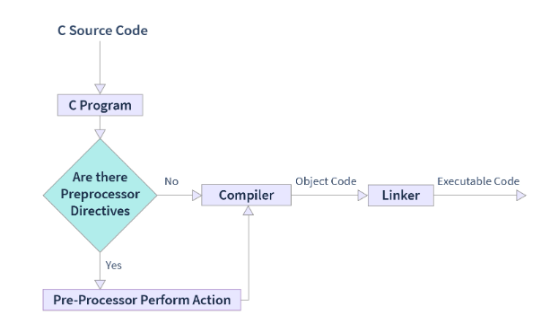
What are Preprocessor and Preprocessor Directives in C Programming?

Slide 11
Types of Macros in C Language

Slide 12
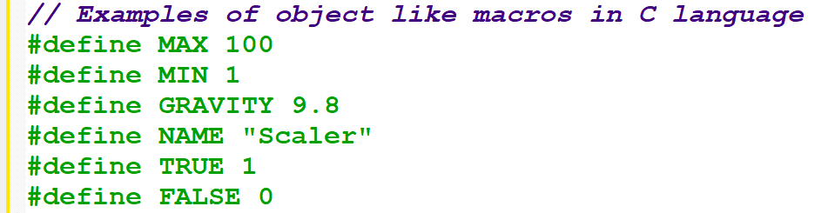
Object like Macros in C
An object like macros in C programming is simply the macros that get replaced by certain values or segments of code.
We can define macros with different datatypes as shown as follows but we can’t use the same macro names for two different values -

Slide 13
Function Like Macros in C
In the function like macros are very similar to the actual function in C programming.
We can pass the arguments with the macro name and perform the actions in the code segment.
In macros, there is no type checking of arguments so we can use it as an advantage to pass different datatypes in same macros in C language.

Slide 14
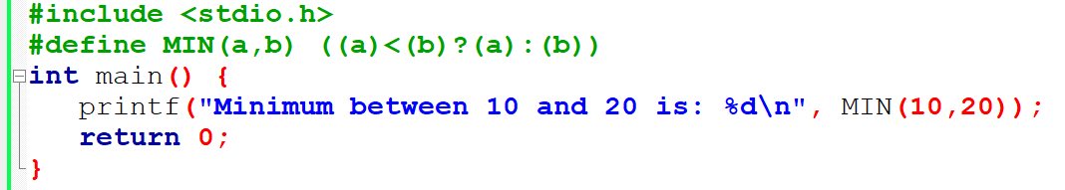
Function Like Macros in C

Slide 15
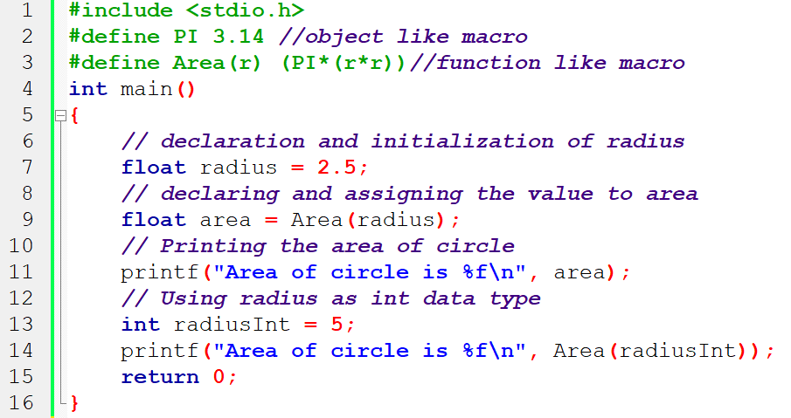
Macros in C

Slide 16

Chain Like Macros in C
When we use one macro inside another macro, then it is known as the chain-like macro.
We already saw the example of a chain-like macro in the above code example where we used the PI in Area. Let's discuss it a little more -

Slide 17
Predefined Macros in C Language
There are some predefined macros in C that we can directly use in the program and they aren’t modifiable.
We can perform so many different tasks with predefined macros which isn’t possible with the normal C programming.

Slide 18
Predefined Macros in C Language
Macro | Feature
__LINE__ Macro | It contains the current line number on which this macro is used.
__FILE__ Macro | It contains the name of the file where the current program is present.
__DATE__ Macro | It contains the current date in MMM DD YYYY format.
__TIME__ Macro | It contains the current time in HH:MM format.
__STDC__ Macro | It is defined as 1 when there is a successful compilation.

Slide 19
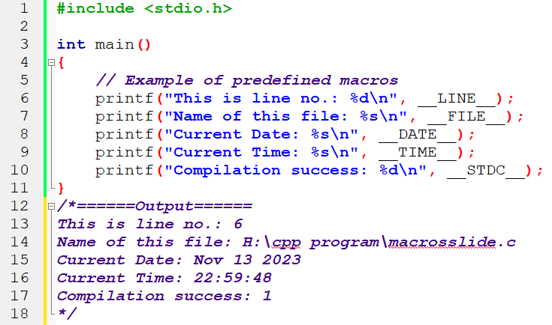
Predefined Macros in C Language

Slide 20
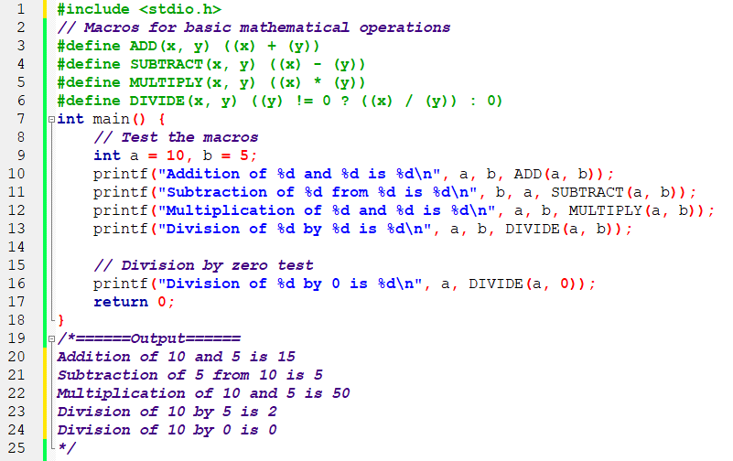
C program that defines a set of macros for basic mathematical operations

Slide 21
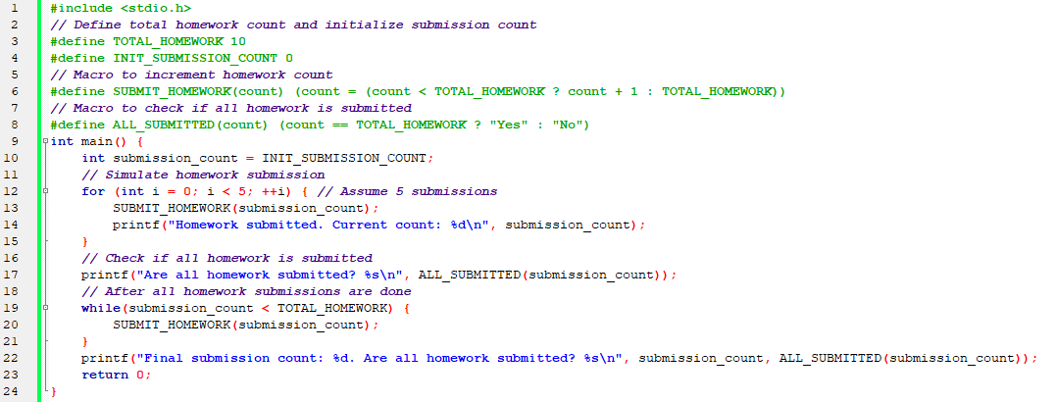
Homework Submission Tracker

Slide 22
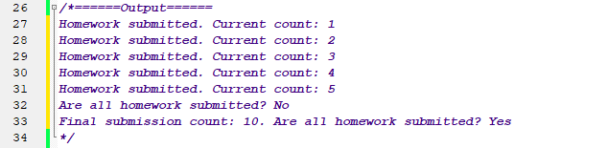
Homework Submission Tracker:: Output

Slide 23
Conclusion
Macro is a piece of code or value that is replaced with the macro name before the execution of the program.
Preprocessor performs different actions on preprocessor directives and for the macro definition, we use the #define preprocessor directive.
The work of #define is that it replaces the macro body with the macro value at the time of preprocessing.
It is a good idea to use the macros in code as per the requirement and utilize the different types of macros.
Predefined macros can do so many things which aren’t possible with normal C programming.

Slide 24
Homework
Grading System Using Macros: A program that defines macros for grading thresholds. Students enter their scores, and the program uses the macros to assign a grade based on predefined thresholds.

Slide 25
Thank You

